Slide 1
Firewall
Files: firewall
Notes:
https://www.youtube.com/watch?v=6G3qm60dfA8&ab_channel=PrashantThombre

Slide 2


What is Firewall
A firewall is a network security device that acts as a barrier between a private network and the public internet or other networks.
Its primary purpose is to monitor and control incoming and outgoing network traffic based on predetermined security rules.
Intrusion detection and prevention
Malware detection, and content filtering.
Internet
ICDFA Academy
Network-based firewall

Slide 3
The importance of a firewall
Protect the network from unauthorized access, data breaches, and other security threats.
Approach
Blocking or allowing traffic based on specific criteria, such as IP addresses, ports, protocols, and applications

Slide 4
Firewalls Deploying Methods
Network-based firewall
A device that sits between the internal network and the external network (usually the internet) and filters traffic based on predefined rules.
It provides a centralized security solution for the entire network and can control traffic from multiple hosts.
Network-based firewalls are effective at protecting against external threats, such as hackers and malware, but they may not be as effective at controlling internal traffic.
Host-based firewall
installed on individual hosts (such as servers or workstations) and filters traffic on a per-host basis.
It provides a more granular level of control and can be customized for each host's specific needs.
Host-based firewalls are effective at protecting against internal threats, such as unauthorized access by insiders or malware that has already infected a host, but they may not be as effective at protecting against external threats.

Slide 5
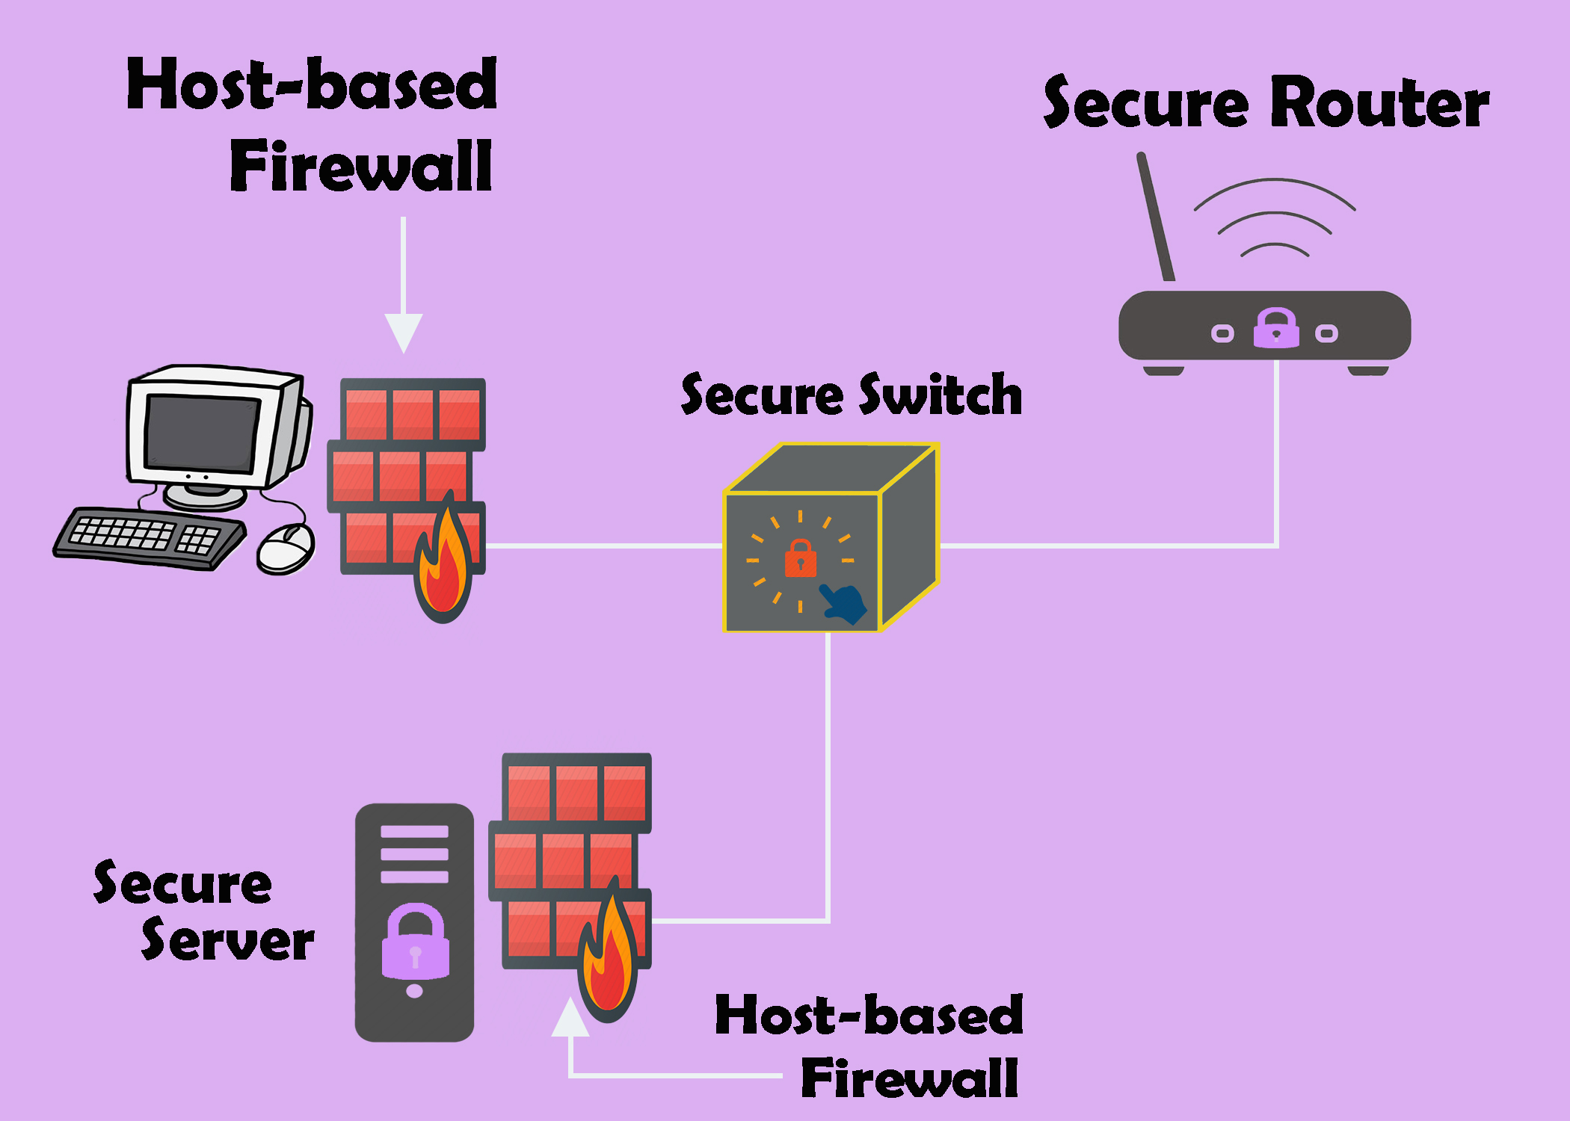
Notes:
https://cybersecurityglossary.com/wp-content/uploads/2019/08/host-based-firewall.jpg

Slide 6
Linux Firewall (iptables)

Slide 7
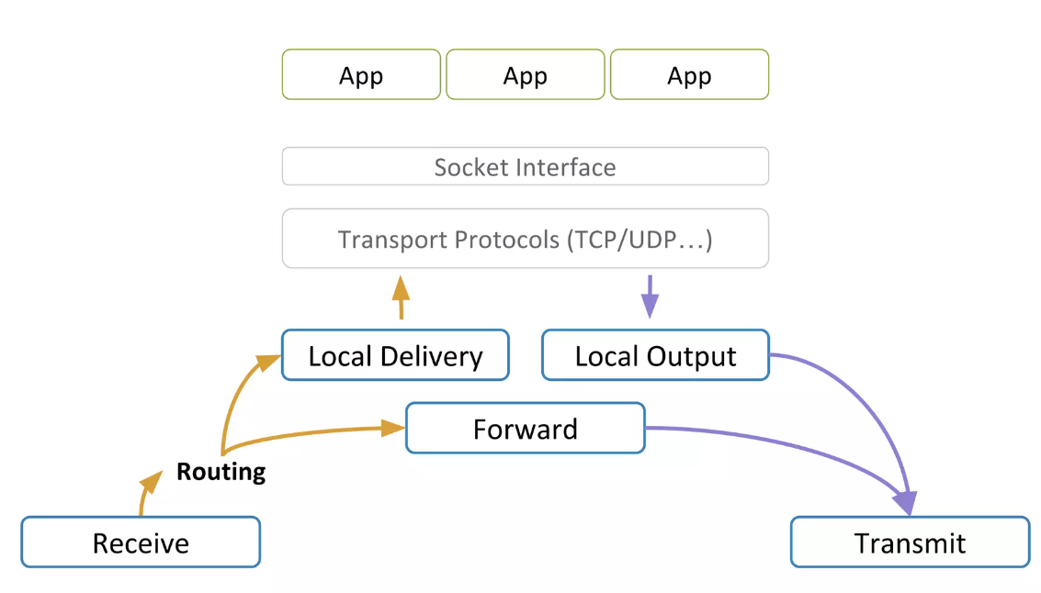
Host-based Routing Process
We focus on
Notes:
https://www.slideshare.net/kerneltlv/netfilter-and-iptables

Slide 8


Host-based Firewall
Notes:
https://www.slideshare.net/kerneltlv/netfilter-and-iptables

Slide 9


Linux Firewall and iptable
reject X
In
Accept
modify
/
iptables is a software firewall
pre-installed on most Linux-based operating systems.
Linux Firewall defines a set of rules that determine how network traffic is allowed or blocked on a system
These rules are organized into chains, which are lists of rules that are evaluated in sequence.
Each rule can match packets based on various criteria
such as the source or destination IP address, the protocol, and the port number.
When a rule matches a packet, it can perform an action
such as accepting, rejecting, or modifying the packet.
The "iptables" command-line utility is used to manage the firewall rules
it provides a powerful and flexible way to control network traffic on a Linux system.

Slide 10
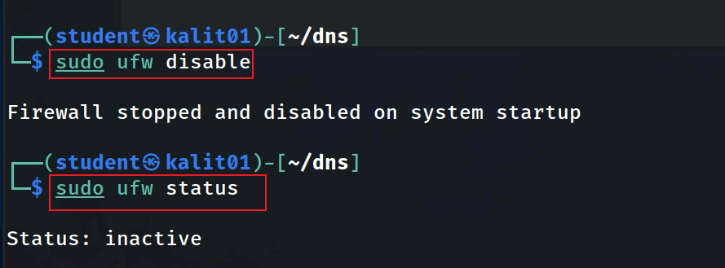
iptables vs. ufw
UFW (Uncomplicated Firewall) is a front-end tool for managing iptables firewall rules on a Linux system.
UFW does not have its own set of rules separate from iptables
it translates the rules into iptables commands and applies them to the firewall.
it provides a simplified interface to manage iptables, which is a command-line utility for configuring netfilter firewall rules in the Linux kernel.
disable ufw to void conflits with iptables before the lab

Slide 11
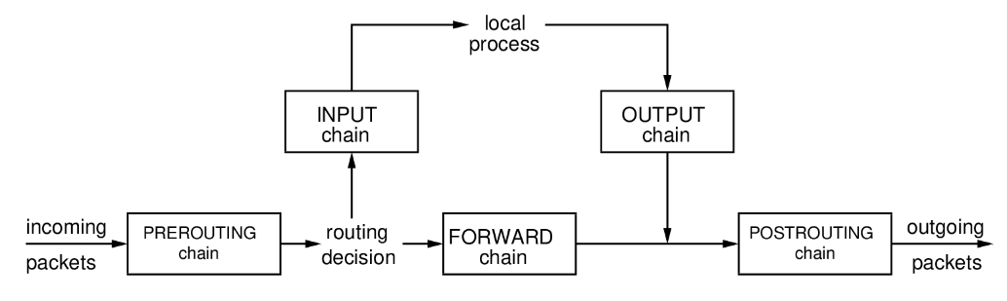
Chains in iptables
iptables defines classes of rules called chains). Rules from each chain are applied based on where the packet is from/going to
Notes:
https://sandilands.info/nsl/Firewallswithiptables.html

Slide 12
Rules in iptables
Packet match conditions:
IP source address
IP destination address
TCP/UDP source port number
TCP/UDP destination port number
Other IP/TCP/UDP header fields
Direction of traffic:
Is the packet coming from outside (to inside) or is it coming from inside (to outside)
Actions:
ACCEPT or DROP

Slide 13
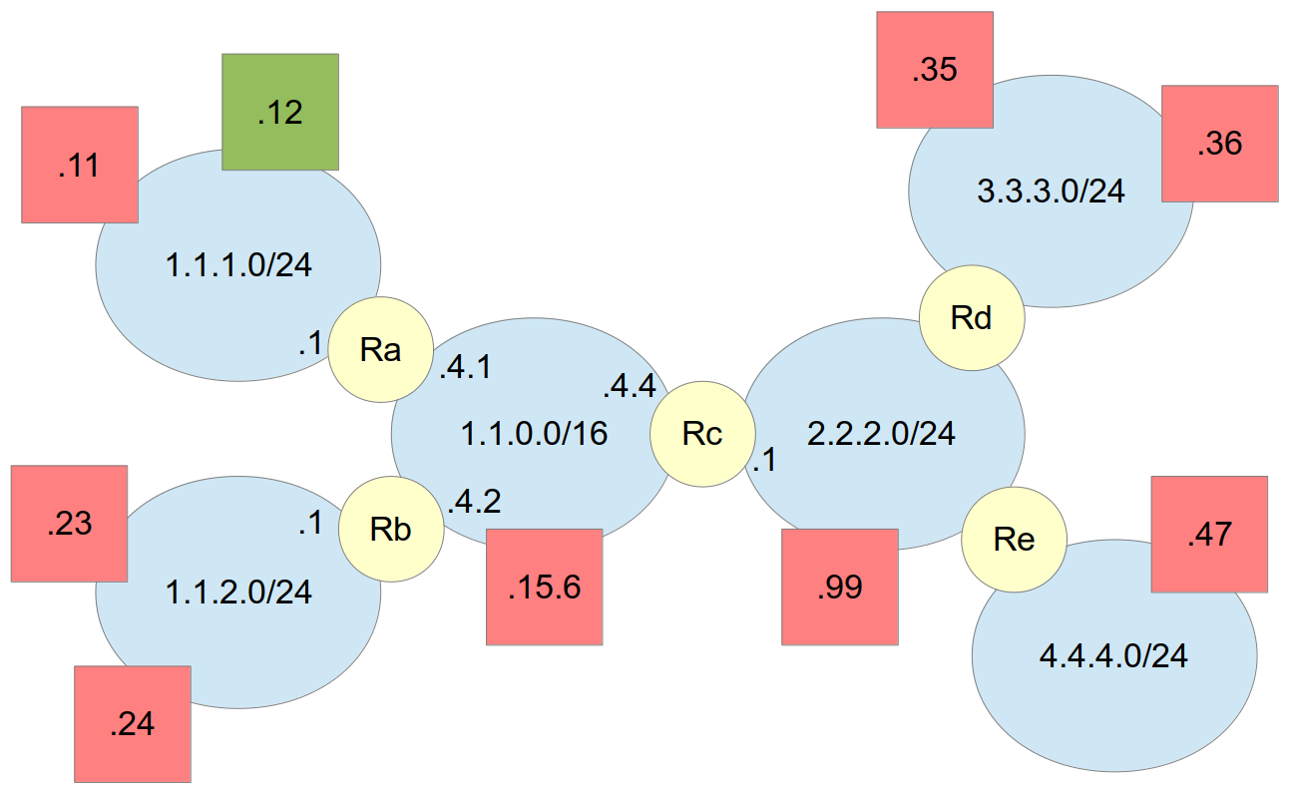

Host-Based Firewall running on 1.1.1.12
Notes:
https://sandilands.info/nsl/Firewallswithiptables.html

Slide 14
Add rules to iptables

Slide 15
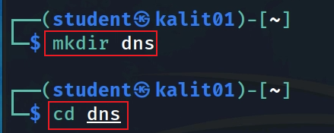
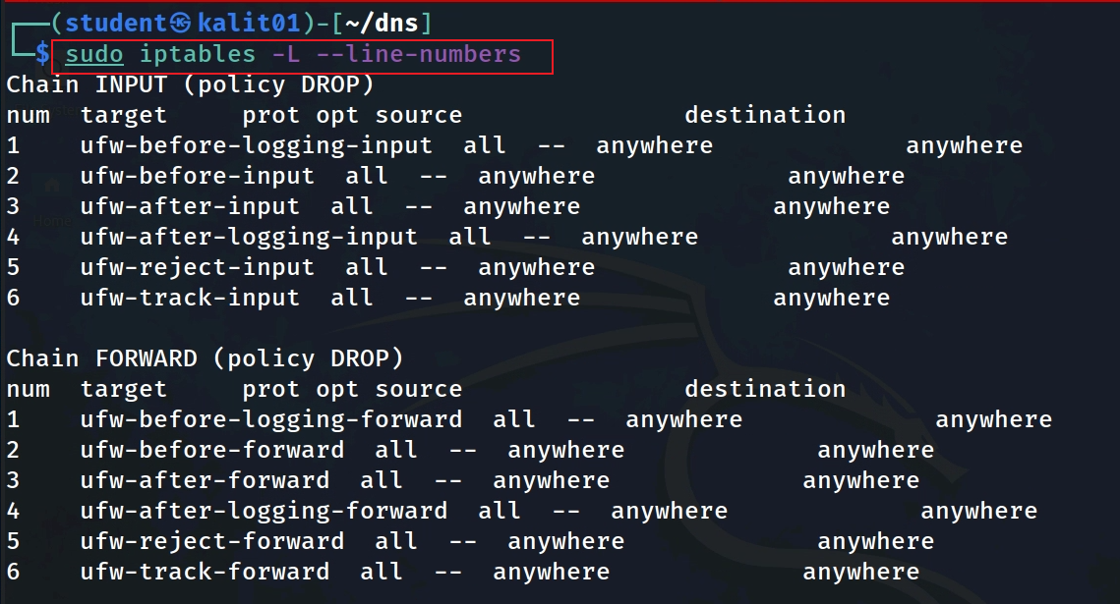
Show current rules in iptables
Input/forward/output chains
Notes:
sudo iptables -L --line-numbers

Slide 16
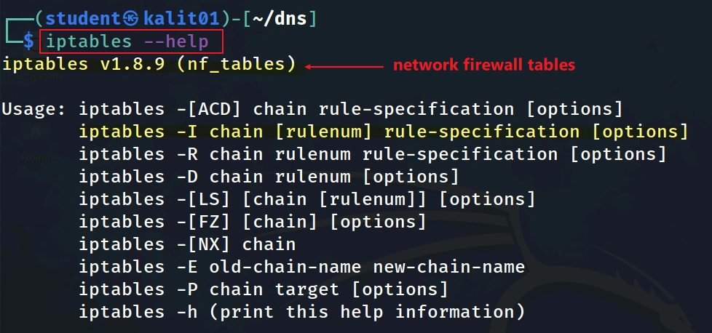
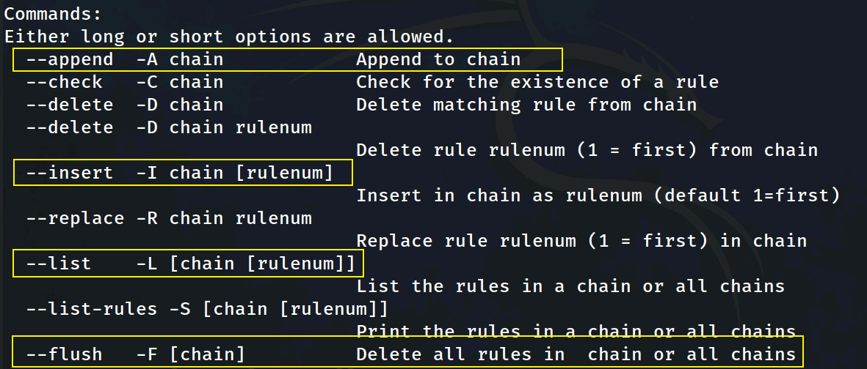

Slide 17
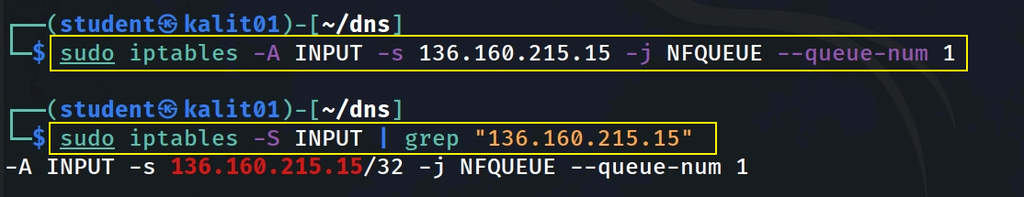
Add a firewall rule to Kali
Adds a new rule to the INPUT chain that matches incoming traffic from the IP address 136.160.215.15 and sends it to a Netfilter queue with ID 1 for further processing.
sudo - runs the command as the superuser, which is necessary since iptables requires elevated privileges to modify the firewall rules.
iptables – a command-line tool to configure Netfilter, the Linux firewall system.
-A INPUT - appends a new rule to the INPUT chain.
-s 136.160.215.15 - the source IP address for the rule. The rule will only match traffic that comes from this IP address.
-j NFQUEUE - the target for the rule. The NFQUEUE target sends matching packets to a Netfilter queue for further processing.
--queue-num 1 - the ID of the Netfilter queue to use. In this case, we're using queue ID 1.
Notes:
sudo iptables -A INPUT -s 136.160.215.15 -j NFQUEUE --queue-num 1
sudo iptables -S INPUT | grep "136.160.215.15"

Slide 18
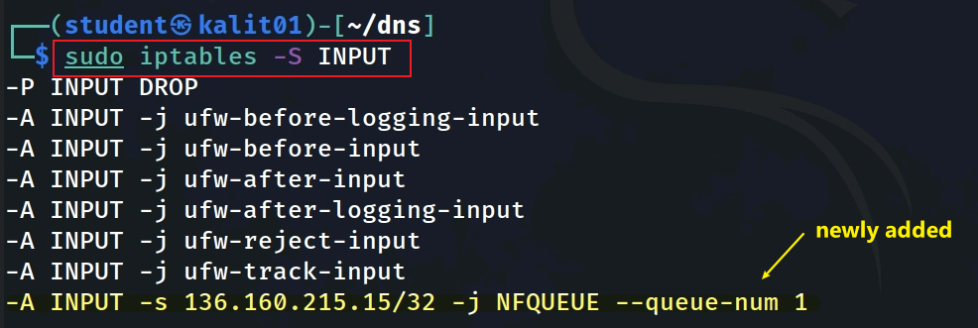
View the newly added firewall rule
-S INPUT: List INPUT chain

Slide 19
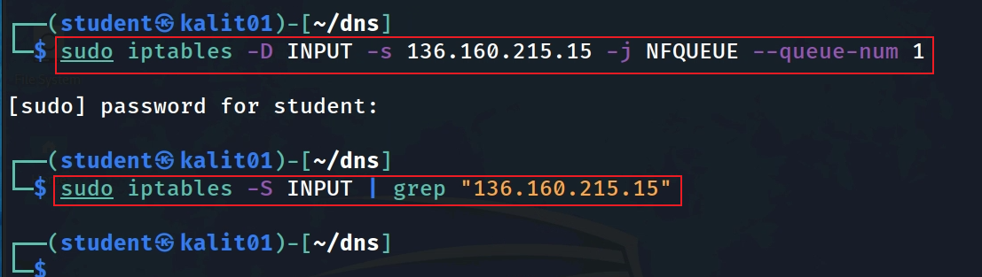
Delete the rule
MUST be the exact same rule specification
Notes:
sudo iptables -D INPUT -s 136.160.215.15 -j NFQUEUE --queue-num 1
sudo iptables -S INPUT | grep "136.160.215.15"

Slide 20
Block a HTTP request
using a rule

Slide 21
Intercept and manipulate network packets
netfilter framework is a set of hooks that can be used to intercept and modify network traffic as it passes through the kernel.
netfilter framework is a part of the Linux kernel
NetfilterQueue library provides a Python interface to the netfilter framework, allowing you to intercept and modify network packets using Python code.

Slide 22
NetfilterQueue
netfilterQueue is useful for a variety of purposes
implementing a firewall,
a packet sniffer, or
a network intrusion detection system.
How netfilterQueue works
creating a userspace application that sets up a netfilter queue and waits for packets to be intercepted and passed to the userspace.
Once a packet is intercepted, it can be modified, dropped, or passed on to its destination, depending on the needs of the application.

Slide 23
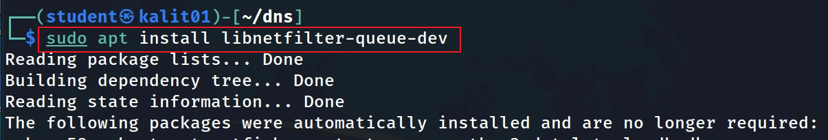
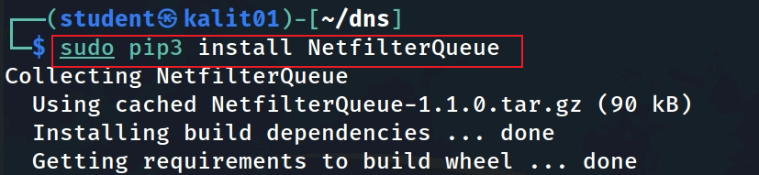
Install NetfilterQueue
Notes:
sudo apt install libnetfilter-queue-dev
sudo pip3 install NetfilterQueue
or
apt-get install build-essential python3-dev libnetfilter-queue-dev

Slide 24
A simple traffic monitor that Uses NetfilterQueue
Intercept the drop packets based on incoming packets’ IP address
wget https://raw.githubusercontent.com/frankwxu/digital-forensics-lab/main/Networking_Forensics/lab_files/firewall/ iptables_handle_packets_drop.py

Slide 25
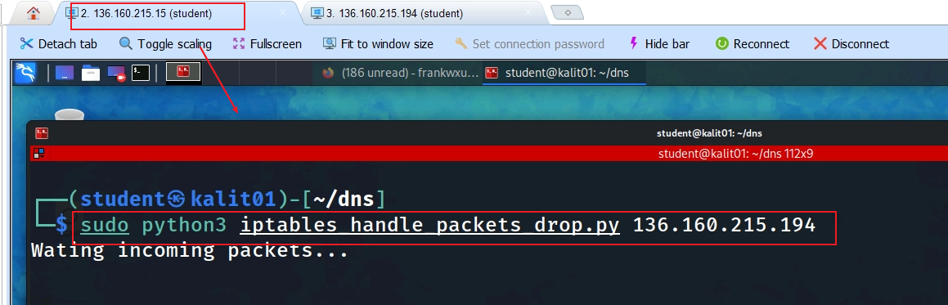
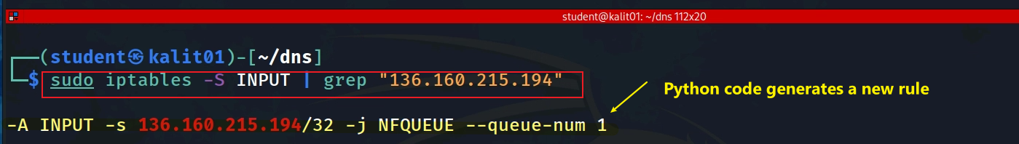
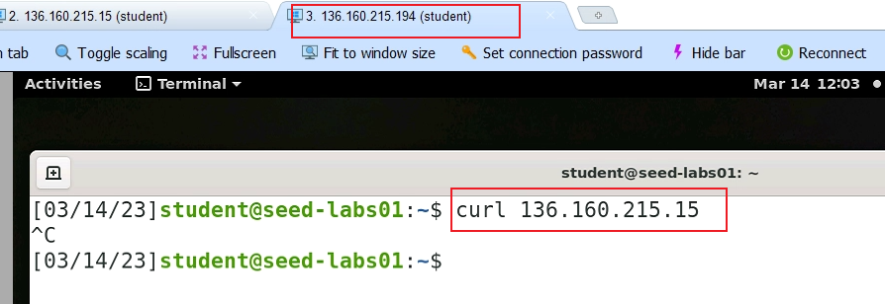
Intercept the drop packets if a packet’s IP address 136.160.215.194
1. Listening and intercepting. It will generate a rule
2. Generating http with
ip.src=136.160.215.194 ip.dst=136.160.215.15
Notes:
sudo python3 iptables_handle_packets_drop.py 136.160.215.194
sudo iptables -S INPUT | grep "136.160.215.194“
sudo iptables -D INPUT -s 136.160.215.194 -j NFQUEUE --queue-num 1

Slide 26
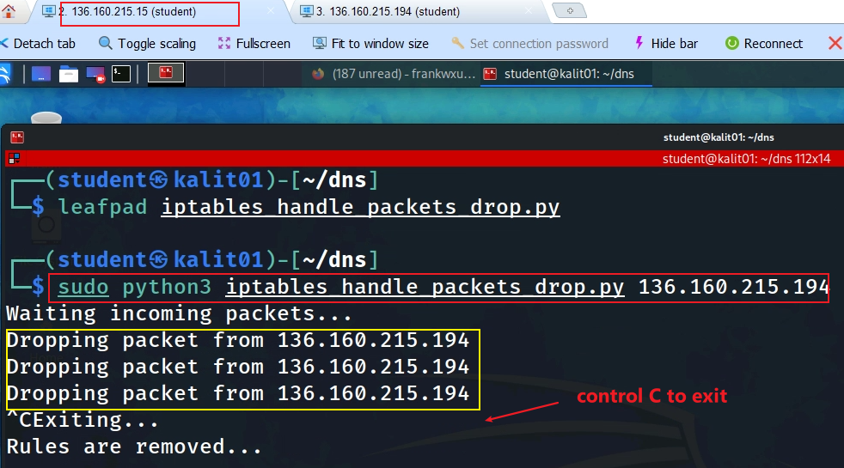
3. observe that packets are dropped

Slide 27

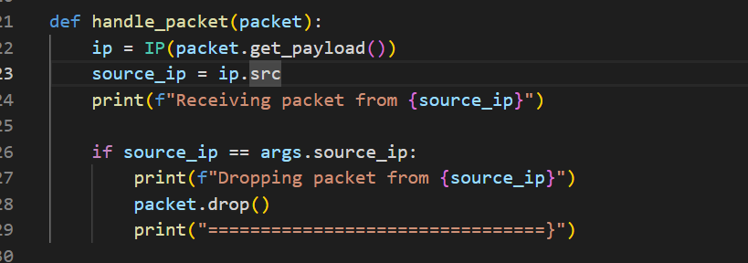
bind the rule with the callback function
Callback function when a rule is triggered
Converting the packet from the NetfilterQueue format to the Scapy format, which allows us to use the Scapy library's functionality to extract information from the packet.
The packet object in this program is an instance of the netfilterqueue.Packet class, which is provided by the NetfilterQueue library.
The NetfilterQueue library allows you to intercept and modify network packets using a userspace application. The Packet class represents a network packet that has been intercepted and passed to the userspace application for processing.
packet.get_payload() method is being used to extract the payload data of the intercepted packet and pass it as an argument to the IP() constructor, which creates an IP object from the packet data.

Slide 28
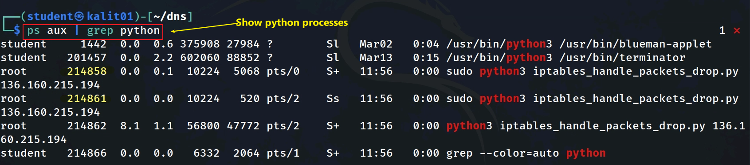
Debug: In case failed to bind filters
Show all python processes
Kill old python processes
Notes:
sudo python3 iptables_handle_packets_drop.py 136.160.215.15
sudo iptables -S INPUT | grep "136.160.215.15"

Slide 29
Block a webpage

Slide 30
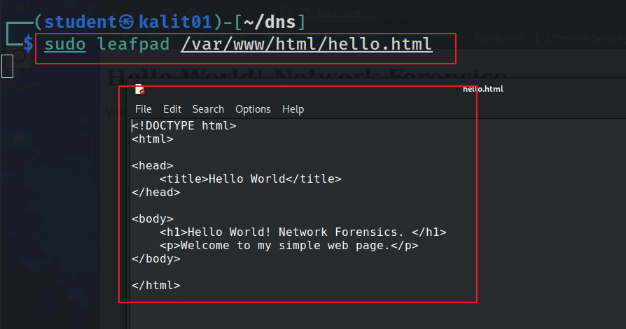
Create a web page
wget https://raw.githubusercontent.com/frankwxu/digital-forensics-lab/main/Networking_Forensics/lab_files/firewall/hello.html
sudo cp hello.html /var/www/html/.
Notes:
<!DOCTYPE html>
<html>
<head>
<title>Hello World</title>
</head>
<body>
<h1>Hello World! Network Forensics. </h1>
<p>Welcome to my simple web page.</p>
</body>
</html>

Slide 31
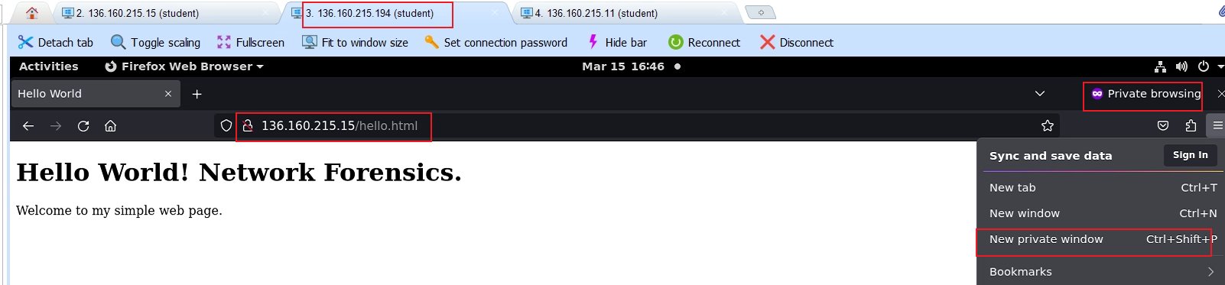
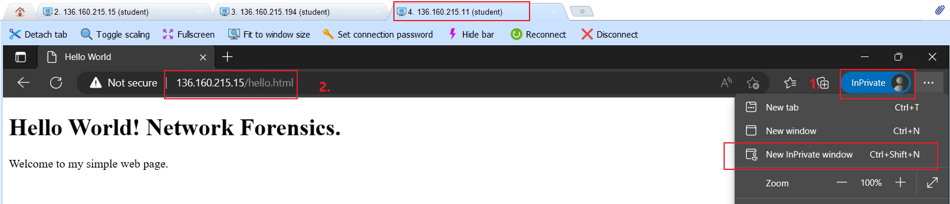
Make sure to use private windows to avoid caches
Before enable a rule of firewall to drop package

Slide 32
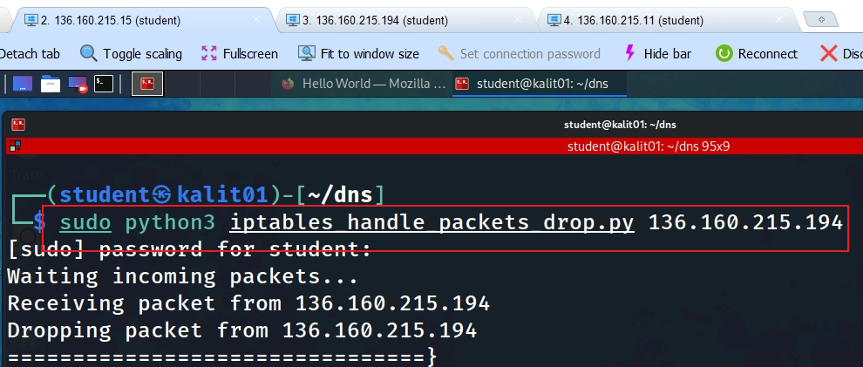
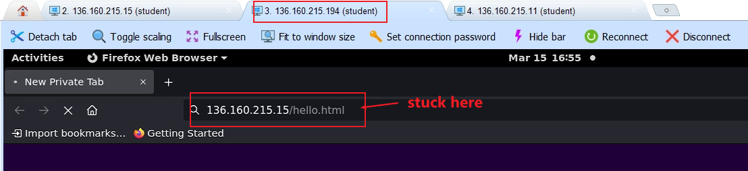
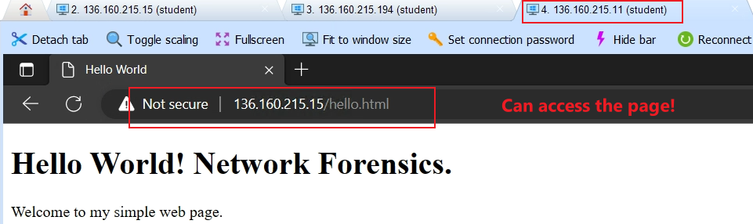
Start the firewall and trigger the rule!
Open a new tab at each host.
.194 is blocked
.15 is allow

Slide 33
Homework
Capture traffic generated by curl command
curl from a different machine and observe the results

